Slide 1
Copyrights & Fair Use
Copyright © BSIT-GMU. All rights reserved.

Slide 2
What is copyright?
“Copyright is a form of protection provided by the laws of the United States to the authors of ‘original works of authorship,’ including literary, dramatic, musical, artistic, and certain other intellectual works.” (US Copyright Office)
The intent of copyright is to advance the progress of knowledge by giving an author of a work an economic incentive to create new works.

Slide 3
What can be copyrighted?
Anything that is tangible can be copyrighted.
Three fundamental requirements:
Fixation
______
Minimal Creativity
Under US copyright law, any original work fixed in a tangible medium is automatically protected by copyright regardless of whether any copyright formalities are done.

Slide 4
Copyright
Copyright provides authors fairly substantial control over their work.
Four exclusive rights:
Reproduction right
___________ right
Modification right
Public performance & display right

Slide 5
What can not be protected by Copyright?
Titles, names, short phrases, and slogans
Ideas, procedures, methods, systems, processes, concepts, principles, discoveries, or devices
Works in the _________
Government works, which include:
Judicial opinions
Public ordinances
Administrative rulings
Works created by federal government employees as part of their official responsibility

Slide 6
What will happen if you are found liable for copyright infringement in the US?
The copyright owner can sue infringers for
damages (the owner's lost profit)
profits (any profit the infringer made)
statutory damages (up to $30,000 per item (song, movie, etc.) and up to $150,000 for willful infringement)
attorney's fees and costs
The court may order impoundment and destruction of the instrumentalities that made the copying possible.
E.g., computer, hard disk, backup media, MIDI keyboard, modem, and other hardware and software.
It is also a criminal act to violate Federal copyright law
It may qualify as a Federal misdemeanor (with a fine as much as $10,000 or imprisonment for up to one year.)

Slide 7
What is Fair Use?
Section 107 of the Copyright Act allows portions of a copyrighted work to be used without the author's permission for specific purposes; referred as "fair use."
E.g., criticism, comment, news reporting, teaching, scholarship, and research
Section 107 also sets out four factors to be considered in determining whether or not a particular use is fair
The purpose and character of use
The nature of the copyrighted work
The amount and substantiality of the portion used in relation to the copyrighted work as a whole
The effect of the use upon the potential market for or value of the copyrighted work.

Slide 8
Fair Use Guidelines for Educational Multimedia
http://depts.washington.edu/uwcopy/Using_Copyright/Guidelines/Fair.php
The guidelines provide guidance for the use, without permission, of portions of lawfully acquired copyrighted works.
The guidelines are intended to apply to educational multimedia projects that incorporate students’ or educators’ original material, such as course notes or commentary, together with various copyrighted media formats, including motion media, music, text material, and graphics illustrations.

Slide 9
Student & Faculty Guidelines
Students
May incorporate portions of copyrighted materials when producing a project for a specific course.
May perform or display their own projects and use them for job interviews or application to graduate school.
Faculty
May incorporate portions of copyrighted materials when producing a project for their teaching.
May use their project for assignments for students, remote instruction (provided the network is secure and is designed to prevent unlawful copying), conferences, presentations, workshops, or their professional portfolio

Slide 10
Limitations
Preparation and use of projects created under these guidelines are subject to limitations of
Copying
Distribution
Time
Portion

Slide 11
Copying and Distribution Limitations
Up to ___ copies
1 copy for preservation purposes
Each principal creator of a joint project may retain one copy.
Students may retain one copy of their personally created educational projects only for their portfolios and for job and graduate school interviews.
Distribution must be limited to students enrolled in the course and there must be "technological limitations on access to the network and educational multimedia project (such as password or PIN).”

Slide 12
Time Limitations
Students may perform and display their own educational multimedia projects for educational uses in the course for which they were created.
Educators may retain their own personally created multimedia project for education purposes for a period up to two years after the first instructional use with a class
When duplication cannot be prevented (over an otherwise secure network)
Educators and students may use the educational multimedia projects for a period of only ___ days after its initial real-time remote use in the course of instruction or ___ days after its assignment for directed self-study

Slide 13
Portion Limitations
The amount of a copyrighted work that can reasonably be used in a project regardless of the original medium from which the copyrighted works are taken.
Limits apply cumulatively to each project for the academic semester, cycle or term.

Slide 14
Cautions
The Guidelines recommend caution on several important points:
Attribution and Acknowledgement
Notice of Use Restrictions
Downloading from the Internet
Future Uses Beyond Fair Use
Alterations to Copyrighted Works
Reproduction or Decompilation of Copyrighted Computer Programs
Licenses and Contracts

Slide 15
Attribution and Acknowledgement
Crediting the Source
Giving a full bibliographic description where available (including the creator/author, title, publisher, and place and date of publication); AND
Citing the electronic address if the work is from a network source
AND
Displaying the Copyright Notice (if this is shown in the original source)
© (or the word "Copyright") + the publication year + the name of the copyright owner (e.g., © 2009 Jonathan Henke).

Slide 16
Attribution and Acknowledgement (con’t)
For non-textual materials (e.g., images, audio, video clips)
Give credit in a multimedia source page
Give credit on the page
Give credit in the status bar
Give credit in a link title, tooltip, ALT text, etc.
For textual materials
May be included in the same document as the copyrighted text.
May be combined and shown in a separate section of the educational multimedia project

Slide 17
Notice of Use Restrictions
The opening screen of a program (and any accompanying print material) must include a notice:
Certain materials are included under the fair use exemption of the U.S. Copyright Law
Materials are included in accordance with the multimedia fair use guidelines, and
Materials are restricted from further use.

Slide 18
Linking Disclaimer
A ________ is a statement denying an endorsement or waiving liability for a potentially unauthorized activity.
Sample Linking Disclaimer
By providing links to other sites, [name of your website] does not guarantee, approve or endorse the information or products available at these sites, nor does a link indicate any association with or endorsement by the linked site to [name of your website].

Slide 19
Privacy Policy Statement
A privacy policy statement explains how any information submitted by a visitor or gathered automatically through server logs and cookies is used.
Personally Identifiable Information (PII)
E.g., Social Security numbers, credit card numbers, names, addresses, and telephone numbers
Secure Sockets Layer (SSL) Protocol
Cookies

Slide 20
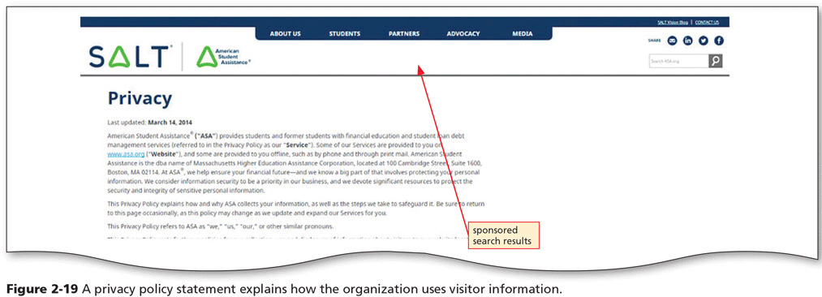
Privacy Policy Statement

Slide 21
Downloading from the Internet
Caution is advised in using digital material downloaded from the Internet.
Internet access does not automatically mean that works can be reproduced and reused without permission or license.
Since October 31, 1988, works no longer need a copyright notice to have copyright protection. This means any image you find on a webpage may be copyrighted.
Some copyrighted works may have been posted to the Internet without authorization of the copyright holder.

Slide 22
About Images
Be very careful where you get your images
Animations should not contain elements of copyrighted or trademarked works.
Putting an artist's animation or graphic on any website or collection page is an infringement of distribution rights, unless you are sure it is free and not copyrighted.
Changing a graphic without permission is an infringement of the copyright.
Do not link directly to a graphic. Don't include anyone else's URL in the BODY BACKGROUND or IMG SRC tags.

Slide 23
About Links
The simplest method of avoiding linking problems is to seek permission.
As a general rule, permission is never required for a hyperlink that uses highlighted text (a text link).
The following types of links may cause disputes; it makes sense to ask for permission:
Deep links that bypass a linked site's home page.
Links that result in framing.
Image links that pull only certain elements from a site (such as an image).

Slide 24
In Conclusion…
WWW is NOT public domain.
Educational purpose is NOT always FAIR USE.
Out-of-print does NOT mean out-of-copyright.
No copyright notice is required online or in hardcopy to protect an author.
Always credit the source of your information.
Find out if the author of a work (e.g., video, audio, graphic, icon) provides information on how to use his or her work. If explicit guidelines exist, follow them.
Whenever feasible, ask the owner of the copyright for permission. Keep a copy of your request for permission and the permission received.

Slide 25



Rights Reserved
Rights Reserved
Public Domain | Copyleft & Creative Commons Licensing | Traditional Copyright
No rights reserved | Some rights reserved | All rights reserved

Slide 26
Creative Commons
Creative Commons builds upon the “all rights reserved” of traditional copyright to create a voluntary “some rights reserved” copyright licenses for authors and artists.
License Your Work
Overview of CC Licenses
Deed
Legal code
How to Give Attribution
https://creativecommons.org/use-remix/get-permission/
Find CC Licensed Materials
Use CC Find
Searches Google, Yahoo, Flickr, blip.tv, etc.
Use CC Content Directories
Searches audio, video, image, text, etc.

